Slide 1
Consumer Behavior
From:
Book 1: Chapter 7

Slide 2
Law of Diminishing Marginal Utility
Utility is the satisfaction one gets from consuming a good or service
“Utility” and “usefulness” are not synonymous.
Utility is subjective.
Utility is difficult to quantify.
LO1

Slide 3
Law of Diminishing Marginal Utility
Util is one unit of satisfaction or pleasure
Total utility (TU) is the total amount of satisfaction
Marginal utility (MU) is the extra satisfaction from an additional unit of the good
MU = ΔTU/ΔQ
LO1

Slide 4
Law of Diminishing Marginal Utility
As consumption of a good or service increases, the marginal utility obtained from each additional unit of the good or service decreases
Explains downward sloping demand
LO1

Slide 5
Total Utility and Marginal Utility
Total Utility
30
(1)
Tacos
Consumed
Per Meal
(2)
Total
Utility,
Utils
(3)
Marginal
Utility,
Utils
TU
20
Total Utility (Utils)
0
1
2
3
4
5
6
7
0
10
18
24
28
30
30
28
]
10
8
6
4
2
0
-2
10
]
]
0
1
2
3
4
5
6
7
]
]
]
10
8
]
6
Marginal Utility (Utils)
4
2
0
-2
1
2
3
4
5
6
7
MU
LO1

Slide 6
Quick Quiz
Marginal utility in the example is positive, but declining, when total utility is positive and:
a. rising at an increasing rate.
b. falling at an increasing rate.
c. rising at a decreasing rate.
d. falling at a decreasing rate.

Slide 7
Theory of Consumer Behavior
Rational behavior
Preferences
Budget constraint
Prices
LO2

Slide 8
Utility Maximizing Rule
To maximize satisfaction, the consumer should allocate his or her money income so that the last dollar spent on each product yields the same amount of extra (marginal) utility.
When the consumer has “balanced his margins” using this rule, he has achieved consumer equilibrium and has no incentive to alter his expenditure pattern.
Algebraically
MU of product A MU of product B
Price of A Price of B
=
LO2
6-8

Slide 9
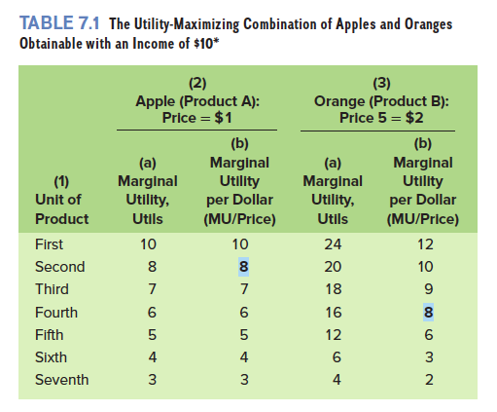
Numerical Example

Slide 10
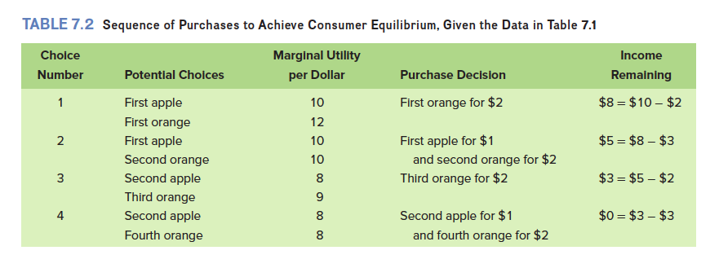
Decision-Making Process

Slide 11
There’s No Accounting for Taste (p. 144)
In 2015, the federal government started requiring restaurants to print calorie counts next to menu items. The regulation was intended to help consumers make healthful choices. In particular, it was assumed that if they could see how many calories each item contained, consumers would consume fewer total calories. They would opt for salads instead of milkshakes.
But a funny thing happened when the new rules went into effect. Some people started consuming more calories. They did so because their preferences were not what policymakers expected. Instead of trying to maximize the amount of healthfulness per dollar of money spent, they instead chose to maximize the number of calories per dollar of money spent. Their preferences were such that when it came to maximizing utility, what they wanted was the maximum number of calories, not the maximum amount of health. So when the new regulations provided them with calorie counts, they went for milkshakes instead of salads and double cheeseburgers instead of chicken skewers.
The lesson learned? Know what people are trying to maximize before you attempt to alter their behavior.

Slide 12
Applications and Extensions
iPads
The Diamond-Water Paradox
Opportunity Cost and the Value of Time
Medical Care Purchases
Cash and Noncash Gifts

Slide 13
Reading Assignment
“Criminal Behavior”
Book 1, Page 147

